Slide 1
Load Testing Web Applications
Presenter: Niko Mađar, QA Engineer at Lemax

Slide 2
About me
Finished university as a systems/network engineer
Worked as a sys/network admin
Started working in QA 4/5 years ago
Most of it in the enterprise telecommunications industry
1 year at Lemax as QA Engineer
Worked extensively with test automation
Proponent of strong processes and organizational structures
Passionate about quality and my work

Slide 3
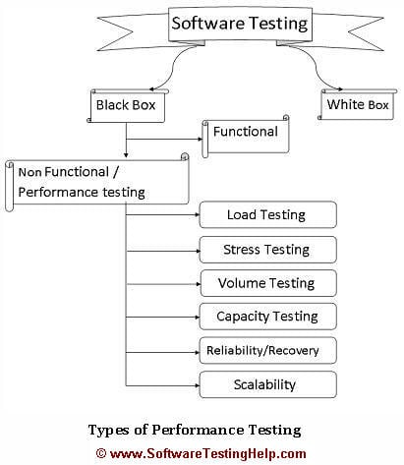
Types of tests
Functional
Feature, Usability, Localization…
Non-Functional
Load
Stress
Security
Recovery
Scalability
...

Slide 4
Load Testing
Load Testing is a type of performance test where the application is tested for its performance on normal and peak usage.
Importance:
Knowing how much your application can handle
Finding possible bottlenecks and optimization candidates
Avoiding outages
Assuring SLAs
The potential of uncovering hidden issues with the application
Notes:
Load Testing is a type of performance test where the application is tested for its performance on normal and peak usage.
The performance of an application is checked with respect to its response to the user request and its ability to respond consistently within an accepted tolerance on different user loads.

Slide 5
Who needs to do it?
If your application:
Expects multiple concurrent users
Has the potential of rapid demand increase
Has SLAs that govern performance characteristics
Relies on availability in peak times to be profitable
Notes:
Example for last point is a ticket selling service. When peak is reached it should be reliable, other services sell tickets if they don't. Competition.
Or a goverment emergency services website.
Missed revenue.

Slide 6
The steps
Planning
Setup/Modeling
Execution
Analysis/Cleanup
Reporting

Slide 7
Planning
Understanding the architecture of the SUT (system under test)
Monolithic, microservices, REST/SOAP, UI, clustered, single instance, virtualized...
What will be needed to test the application
Workstation, Virtual machines, Server, Cluster
Available resources
People, hardware, software, time

Slide 8
Setup / Modeling
Prepare automated scripts or programs
Prepare data for test
Prepare environment for test
Coordination with OPS team if they are responsible for the SUT setup
Prepare log collection and performance monitoring tools
Again coordination with OPS team if needed
Create load testing window (no maintenance during the load test execution)

Slide 9
Execution
Running the automated scripts or programs
Monitoring test automation and SUT
React to possible issues
Depending on type of test execute additional scripts during the testing window

Slide 10
Analysis/Cleanup
Collect results of load tests
Analysis of collected data
Clean up of environments (database restore, cache wipe…)
Preparation of data for reporting
Notes:
Collect all data, remote into machines, copy results. Export to usable formats. Prepare data for reporting
Find out what passed and what failed. What behaved as expected and what didn’t
Analyze the collected data and collect that data metrics you are interested in.
Clean up the environments if needed. Clean the databases, Bring it back

Slide 11
Reporting
Create reports for the executes load scenarios
Choose only the important data points
Construct the reports depending on who the intended audience is
Try to design reports in such a way that no additional material or explaining is needed to understand the results
Standardize the report so that past and future results can be easily compared to it
Notes:
Collect all data, remote into machines, copy results. Export to usable formats. Prepare data for reporting
Find out what passed and what failed. What behaved as expected and what didn’t
Analyze the collected data and collect that data metrics you are interested in.
Clean up the environments if needed. Clean the databases, Bring it back

Slide 12
Example

Slide 13
Planning
Architecture is monolithic. One physical server that runs both App and Database
Method of test: SOAP API calls
Resources needed: Workstation (maybe more later on)
Tools needed (API automation tool) - Jmeter
Data - API requests and environment setup
Available resources

Slide 14
Setup/Modeling
Preparing the SOAP requests
Preparing the Load testing tool / script
Configuring the load test scenario/s
Modeling the load over time (flat, gradual increase, peaks)
Configuring the performance monitoring tools
Nagios, Kibana, Splunk, New Relic etc

Slide 15
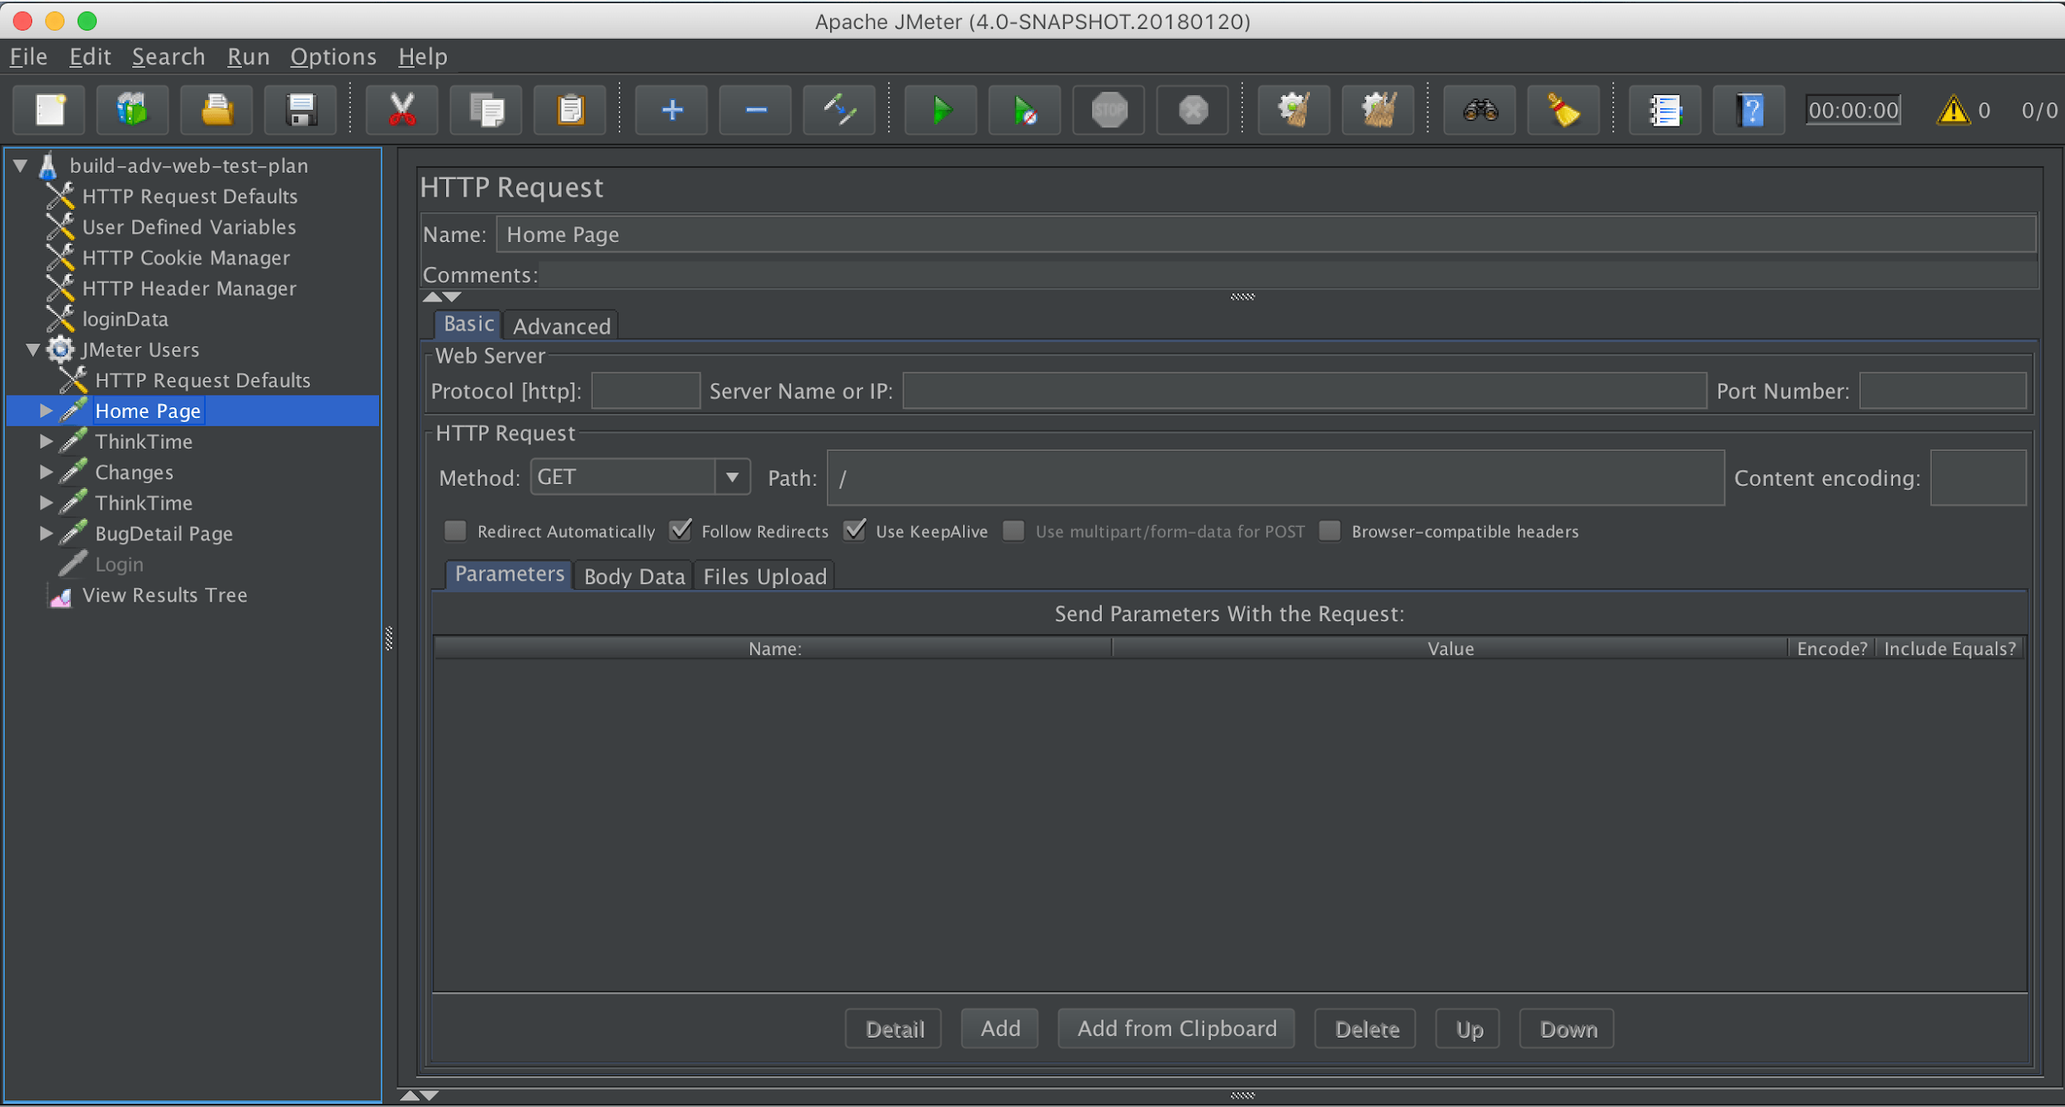

Slide 16
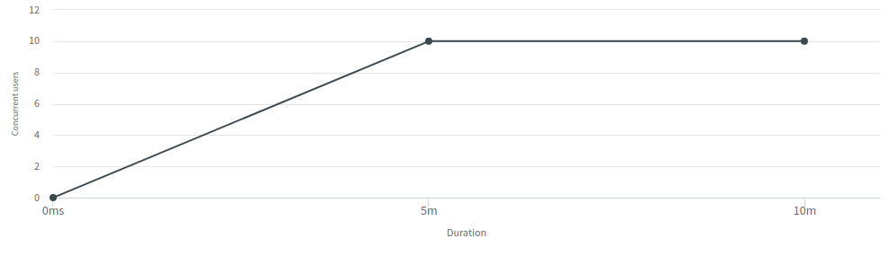
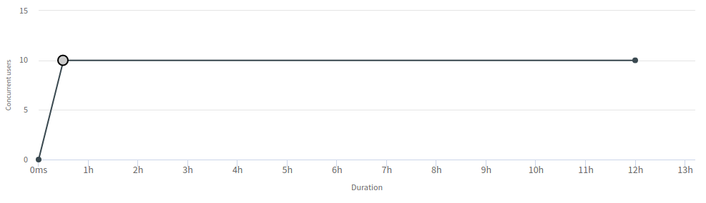

Slide 17
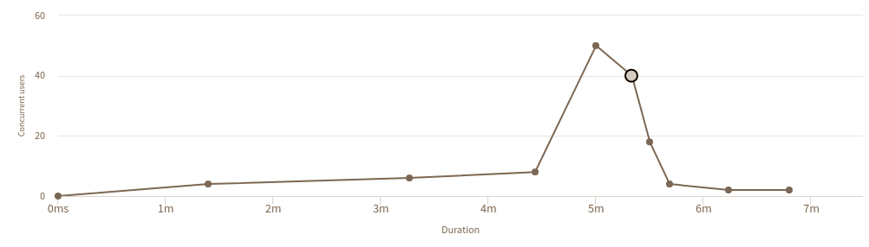
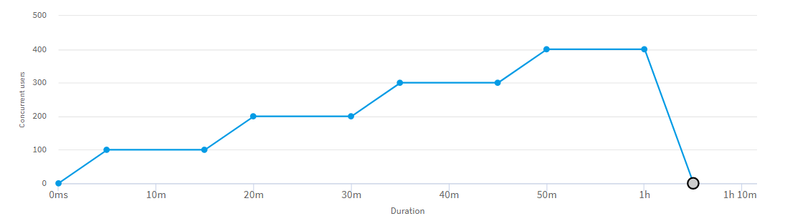

Slide 18
Execution
Executing the load test against the SUT
Monitoring the execution of the load test
Depending on the type of test:
Triggering additional actions on the system
Starting second parallel test suite
Simulating outage or increasing stress on system

Slide 19
Analysis/Cleanup
Collect the result data after the load tests have finished
If executed on remote machines, collect all results and aggregate them
Prepare them so that they can be analysed
Convert the results to formats that are easier to handle
Perform analysis of the results
Use Load testing tools or scripts to parse the collected data
Cleanup the testing environment
DB cleanup
APP restart
Cache invalidation

Slide 20
Reporting
Prepare the reports for review by stakeholders and involved teams
Modify reports depending on who is the recipient
Product, Development, Support etc…
Shape the reports so that everything is clear without the need to additionally explain the results. Avoid complex and confusing graphs
Organize the reports and make sure they are accessible to the relevant teams

Slide 21
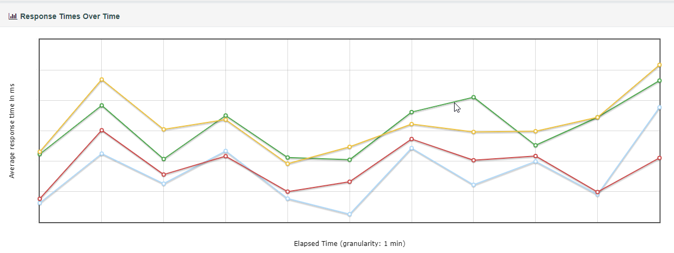

Slide 22
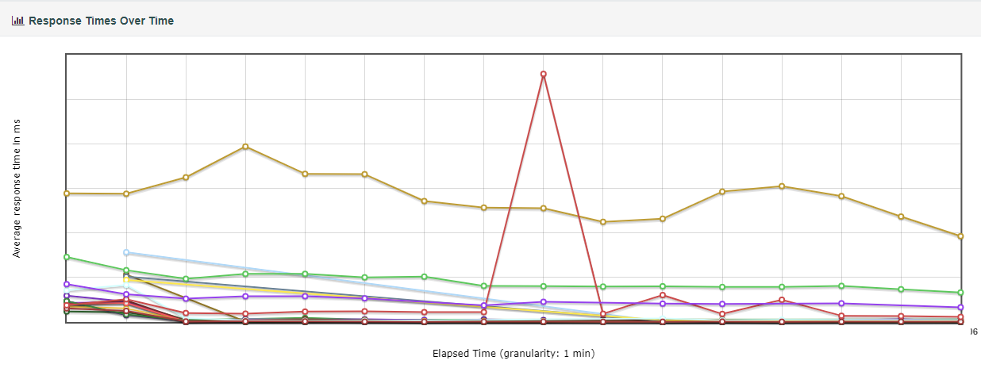

Slide 23
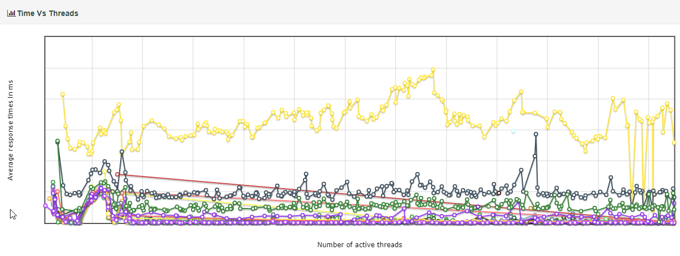

Slide 24
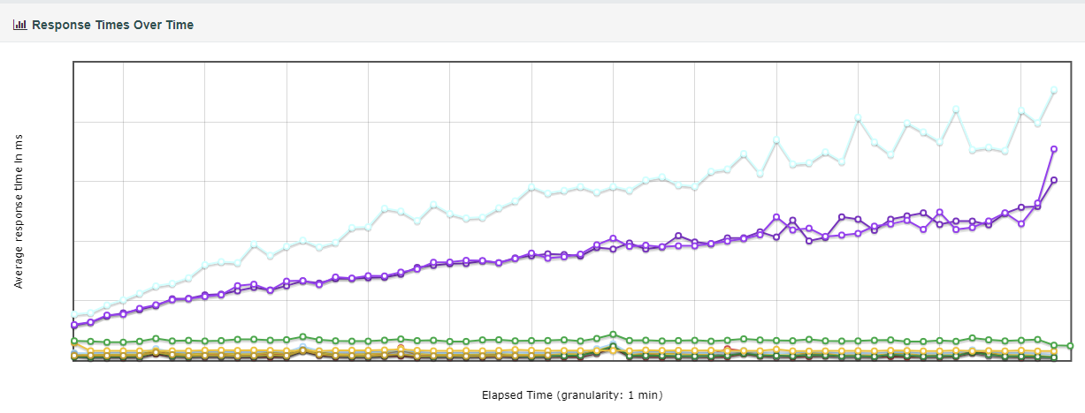

Slide 25
Recommendations and tips
The maximum number of requests depends on CPU, RAM, Network...
Quad Core CPU, 8GB RAM, 10mbit connection ~ 500-700 RPS
Do not use the GUI tools to run the test, use CLI whenever possible
Avoid processing data during the load test, archive it for later analysis
Avoid chain actions, actions that are reliant on previous actions
Avoid result bias when testing. This can impact the setup and execution
Always try to shape realistic usage and accommodate for worst case scenario

Slide 26
Q&A

Slide 27
Thank you for your time

